Slide 1
Brainstorming

Slide 2
시각장애인을 위한 다양한 아이디어 제언
시각장애인 가이드 러너로 활동하면서 개선하고 싶은 아이디어들
1
동반주 끈(Running tether) 개선
2
Matching Program 및 Application 개발

Slide 3
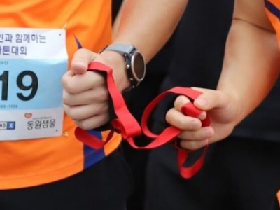
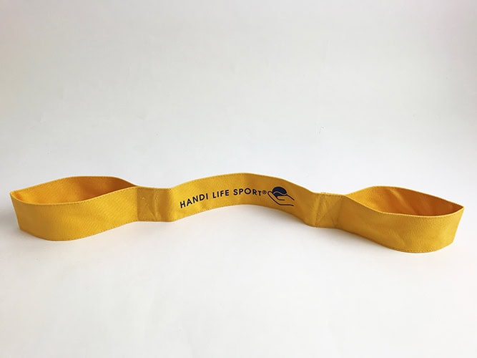
동반주 끈(Running tether)
1
→ 동반주 끈 세계 규정 [참고문헌 1]
World Athletics Rules and Regulations
IPC Para Athletics Rules and Regulations
"A tether may be used, but it shall be non-elastic and not more than 50 cm in length. The athletes shall not be tied or otherwise linked to each other.“ -> 연습용 끈 개발 목표

Slide 4
개선할 점
가이드러너들의 팔목 또는 손에 묶어서 시각장애인에게 방향성을 제공하는 것이 목적이지만, 마라톤 특성상 팔을 움직이는 것은 어쩔 수가 없으므로, 시각장애인에게 방해가 되거나 혼란을 줄 수 있음.
따라서 팔을 자유롭게 흔들 수 있으면서 충분히 시각장애인 상대를 이끌 수 있는 제품 필요

Slide 5
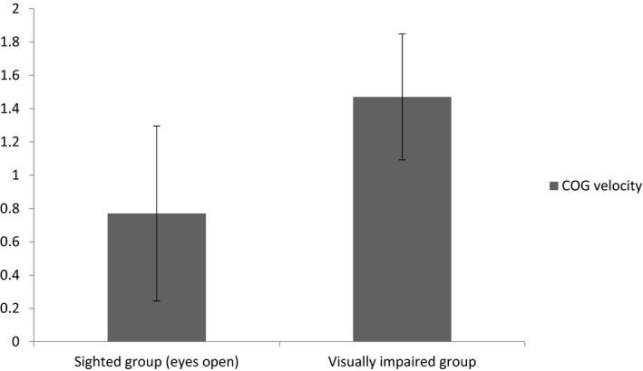
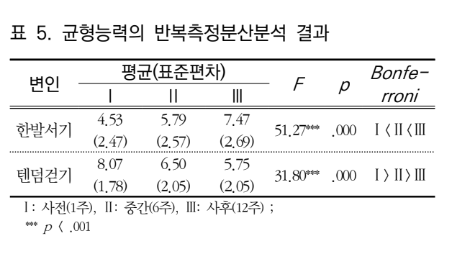
Why do we need this?
As data suggests (see right graph), the visually impaired suffer from high (unstable) COG (Center of Gravity) velocity, and thus, highly susceptible to losing balance, and falling down.
Running tethers of this day does not do anything to help this condition, rather, it worsens it by limiting arm movements, which in turn, makes running much harder for blind individuals.
This technology can promote running as a recreational activity for blind people, which has been proven to help posture and flexibility of the visually impaired.

Slide 6
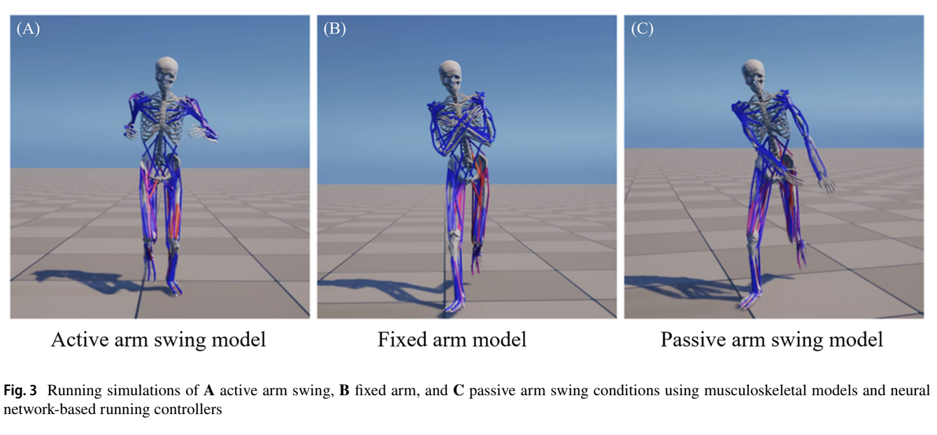
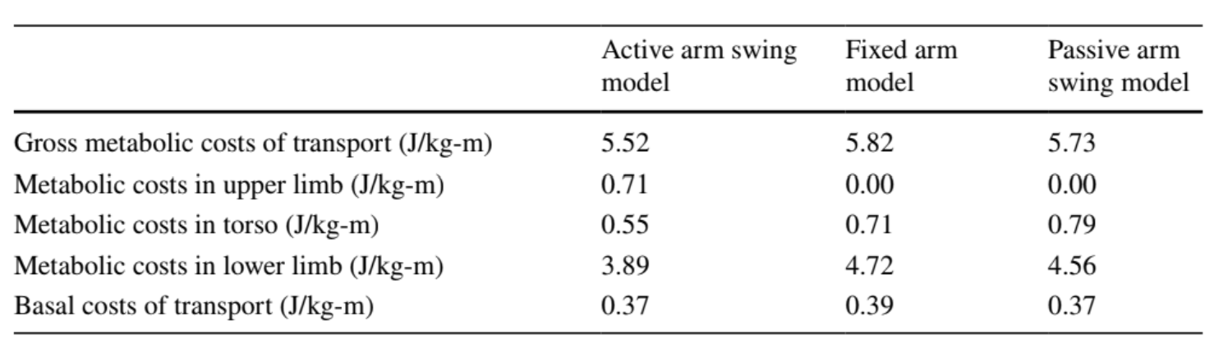
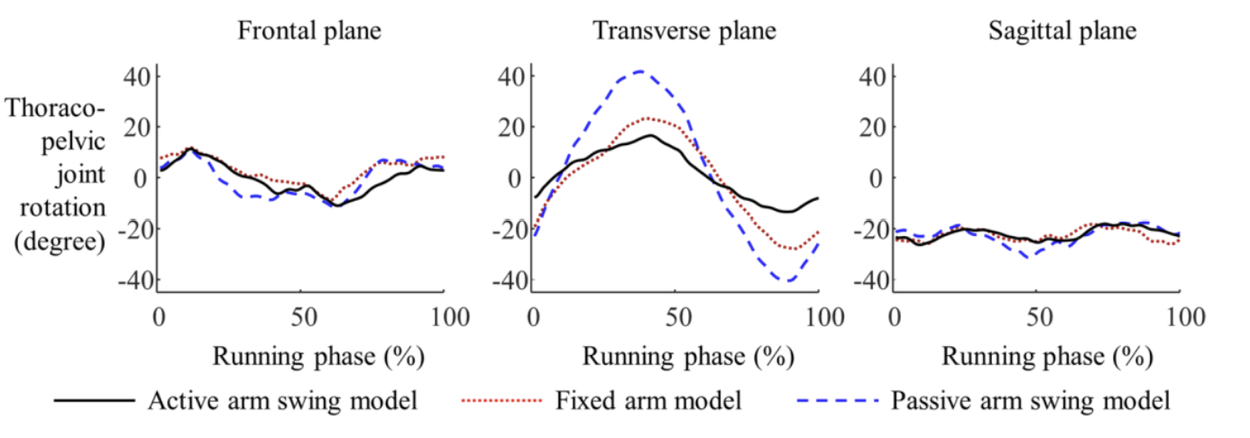
Why do we need this?
Using your arms while running important.
4 to 8% increase in metabolic costs when arm swing was restricted
With much more stable movement when moving with arm swinging.

Slide 7
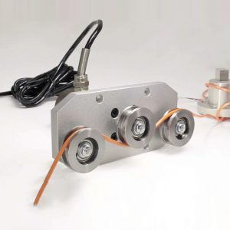
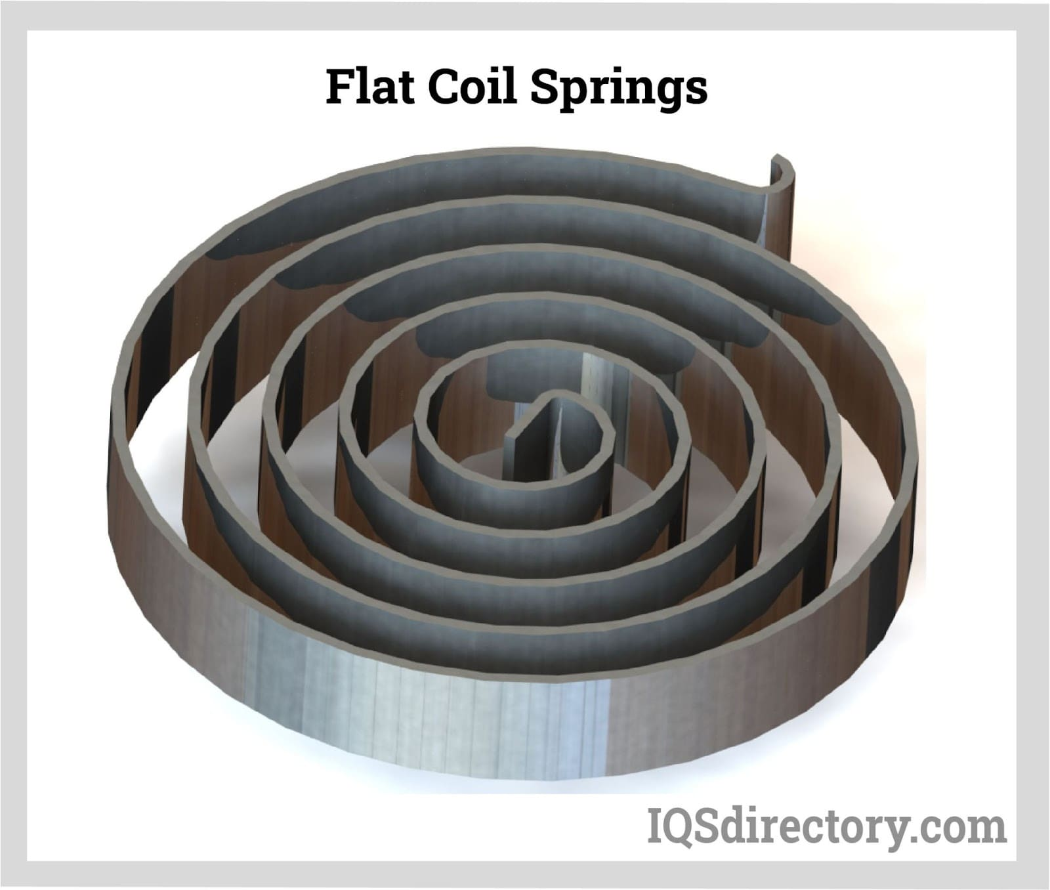
동반주 끈(Running tether) 개선할 점
→ 기존 제품
딱히 특별한 점 없는 fabric or fabric with resistance tubing 소재. 끝에 loop가 있는 점 외 눈에 띄는 특징 없음.
→ 구체적인 사항
팔을 자유롭게 흔들 수 있으면서 충분히 시각장애인 상대를 이끌 수 있는 제품 필요
Tension Sensor를 이용해서 한도를 정한다. 어느정도 줄에 장력이 있어야지 당겨지고, 팔을 흔드는 등 줄을 많이 늘리지 않으면 retractable cord를 이용 (반려동물 목줄 처럼)
Retractable cord 구상하기
Uses flat coil springs, and is equipped with a locking mechanism with a temporary lock.
^ Tension Sensor

Slide 8
Matching Program 및 Application 개발
2
Why?
Accessibility
서울내에는 VMK GRP 등 여러 시각장애인 봉사단체들 존재
하지만, 지방에는 존재하지 않음
But, 서울 – high cost of living (the visually impaired can’t afford to live here) -> 지방에 대부분의 시각장애인이 거주
=> 지방에 거주하는 시각장애인을 위한 플랫폼이 필요함

Slide 9
Matching program web application
System needs:
User accounts & Profiles
Matching logic
Google auth or Kakaotalk auth
Chat (If possible)
User Accounts & Profiles
Running Distance
Running Pace
Running Experience (Records)
Preference & Needs
Layer | Tool
Front End | React.js (Easier) or Next.js (Better SEO)
DB | Supabase (PostgreSQL)
Auth | Google (Easier) or Kakaotalk (Safer)

Slide 10
Matching program web application (Mobile App?)
Option 1: Capacitor (Hybrid Apps)
Much easier, single codebase for mobile + web
Less optimized with slightly worse UI
Option 2: React Native
Near-native performance, Better UI
Much much harder with a learning curve to code, requires more setup, more time
Key Features
Screen reader
Able to send notifications & vibrations
Can access user data with more ease

Slide 11
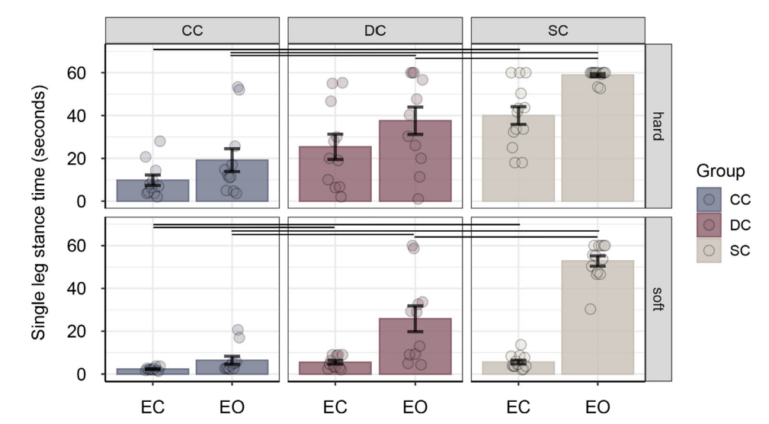
쓸만한 자료 (문헌 2)
we assessed balance and gait in congenitally
cataract-reversal (CC) individuals, developmental
cataract-reversal (DC) individuals, permanently
congenitally blind (CB) individuals, permanently
late blind (LB) individuals, and normally sighted
controls (SCs).

Slide 12
참고문헌
https://worldathletics.org/about-iaaf/documents/book-of-rules
문헌1 Alghadir, Ahmad H., Abdullah Z. Alotaibi, and Zaheen A. Iqbal. "Postural Stability in People with Visual Impairment." Brain and Behavior, vol. 9, no. 11, 2019, e01436. Wiley Online Library, https://doi.org/10.1002/brb3.1436 (slide 5)
문헌 2 Hötting, Kirsten, et al. "Postural Control Depends on Early Visual Experience." Journal of Vision, vol. 24, no. 9, 2024, p. 3. https://doi.org/10.1167/jov.24.9.3 (slide)
문헌 4 Yang, Yunjeong, and Dongmin Kim. "The Effects of the Rehabilitative Exercise Program on Balance and Flexibility in Individuals with Visual Impairments." Journal of Special Physical Education, vol. 31, no. 3, 2023, pp. 39–51. https://doi.org/10.17006/kjapa.2023.31.3.39 (slide 6)
문헌 5 Koo, Young-Jun, et al. "Active Arm Swing During Running Improves Rotational Stability of the Upper Body and Metabolic Energy Efficiency." Annals of Biomedical Engineering, vol. 53, no. 4, 2025, pp. 1003–1013. Springer, https://doi.org/10.1007/s10439-025-03688-0 (slide 6)

